Slide 2
January Prayer Service
Sowing Seeds of Gratitude

Slide 3
“The Summons” “The Light of Christ”
“Christ be Our Light”
“Thanks be to You” Gather by Marty Haugen
“We are Marching” Siyahamba

Slide 4
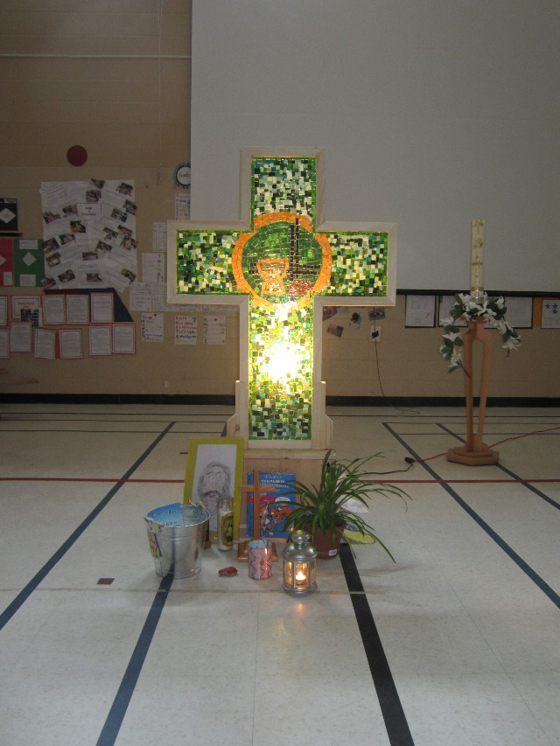
Sowing Seeds of Gratitude Helps us to Spread God’s Love

Slide 5
Opening Prayer
Creator God,
Here in this moment of winter’s darkness, we pause to reflect on your light. With grateful hearts, we give thanks for your creation. Beneath the snow, you bless us with the seeds of promise that will break open again in spring …

Slide 6
… Open our hearts to a spirit of gratitude that we may bring your light to others and the hope that springs from your never ending love. May our gratitude be sown to illuminate your goodness. We make this prayer through Christ our Lord and light. Amen.

Slide 7
Biblical Reading
A reading from the Letter of Paul to the Philippians (4:4-8)
Rejoice in the Lord always; again I will say, Rejoice. Let your gentleness be known to everyone. The Lord is near. Do not worry about anything, but in everything by prayer and supplication with thanksgiving let your requests be made known to God. And the peace of God, which surpasses all understanding, will guard your hearts and your minds in Christ Jesus. Finally, beloved, whatever is true, whatever is honourable, whatever is just, whatever is pure, whatever is pleasing, whatever is commendable, if there is any excellence and if there is anything worthy of praise, think about these things.
The Word of the Lord.
(Thanks be to God.)
Notes:
A reading from the book of Job (Job 12:7-10,13)
Ask the animals, and they will teach you; the birds of the air, and they will tell you; ask the plants of the earth, and they will teach you; and the fish of the sea will declare to you. Who among all these does not know that the hand of the LORD has done this? In his hand is -the life of every living thing and the breath of every human being … With God are wisdom and strength; he has counsel and understanding.
The Word of the Lord. (Thanks be to God)

Slide 8
Questions for Personal Reflection
Where do you see the light of God’s love in the world today?
In this winter season, what makes you want to rejoice and give thanks?

Slide 9
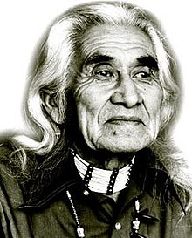
Chief Dan George (1899-1981)
Chief Dan George was chief of the Tsleil-Wantuth Nation, a Coast Salish band located on Burrard Inlet in British Columbia.
He was an actor, poet and author.
He was an Officer of the Order of Canada and was an activist for the environment and for better understanding between non-indigenous and indigenous people.

Slide 10
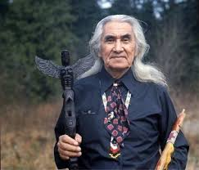
The beauty of the trees,
The softness of the air,
The fragrance of the grass,
Speaks to me.
The summit of the mountain,
The thunder of the sky,
The rhythm of the sea,
Speaks to me.
The faintness of the stars,
The freshness of the morning,
The dew drop on the flower,
Speaks to me.
The strength of fire,
The taste of salmon,
The trail of the sun,
And the life that never goes away,
They speak to me.
And my heart soars.
Chief Dan George

Slide 11
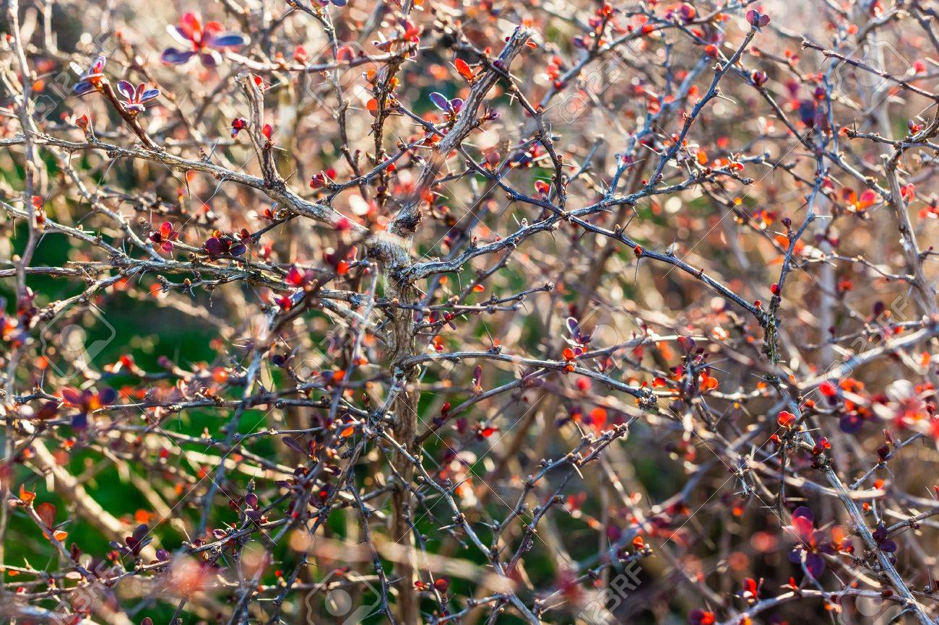
Closing Prayer
A Prayer by Walter Rauschenbusch (1861-1918)
O God, we thank you for this earth, our home; for the wide sky and the blessed sun, for the salt sea and the running water, for the everlasting hills and the never-resting winds, for trees and the common grass underfoot. We thank you for our senses by which we hear the songs and see the splendour of the summer fields, and taste of the autumn fruits, and rejoice in the feel of the snow, and smell of the breath of spring. Grant us a heart wide open to all this beauty; and save our souls from being so blind that we pass unseeing when even the common thorn bush is aflame with your glory, O God our Creator, who lives and reigns for ever and ever. Amen.

Slide 12
Closing Reflection
Planting Seeds: A Song of Life

